Slide 1

Matrices and Linear Algebra
Shiquan Zhang
shiquanzhang@scu.edu.cn

Slide 2
Review of class 1
comments, why and what
Linear systems
Classification
Solution set
homogeneous
inhomogeneous
indefinite (diophantine)
well defined
overdetermined

Slide 3
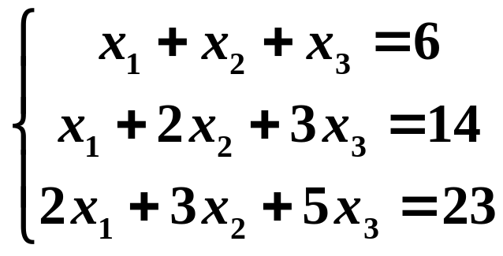
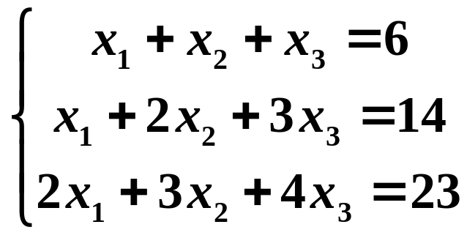
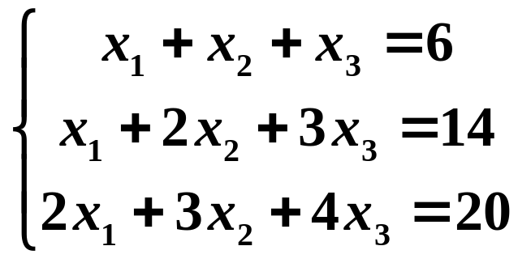
How to judge and solve?
One variable is easy
Elimination method

Slide 4
Equivalent systems
Equivalent systems
Equivalent transformation
Interchange two equations.
2. Multiply an equation by a nonzero constant.
3. Add a multiple of an equation to another equation.
Efficient implementation

Slide 5
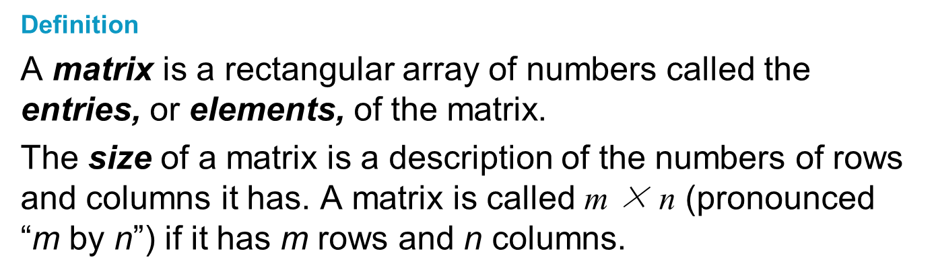
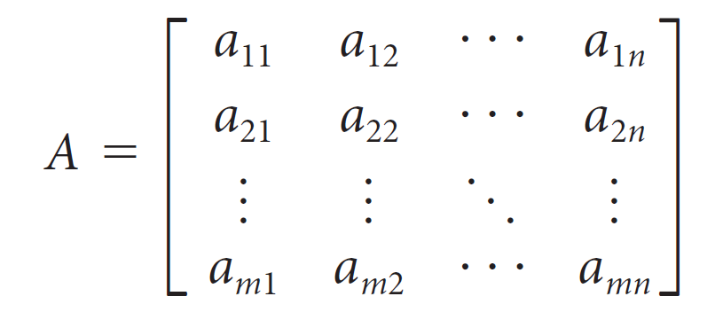
Matrix
We use double-subscript notation to refer to the entries of a matrix A. The entry of A in row i and column j is denoted by a_{ij}.
Coefficient matrix
Augmented matrix

Slide 6
Elementary Row Operations
Definition
The following elementary row operations can be performed on a matrix:
Interchange two rows.
2. Multiply a row by a nonzero constant.
3. Add a multiple of a row to another row.

Slide 7
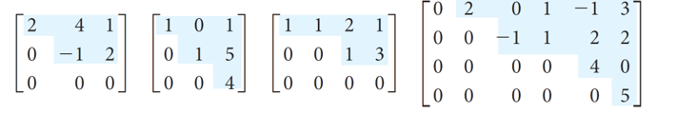
Echelon Form
Definition
A matrix is in row echelon form if it satisfies the following:
1. Any rows consisting entirely of zeros are at the bottom.
2. In each nonzero row, the first nonzero entry (called the leading entry) is in a column to the left of any leading entries below it.
The process of applying elementary row operations to bring a matrix into row echelon form, called row reduction, is used to reduce a matrix to echelon form.

Slide 8
reduced row echelon form
Definition
A matrix is in reduced row echelon form (rref) if it satisfies the following properties:
It is in row echelon form.
2. The leading entry in each nonzero row is a 1 (called a leading 1).
3. Each column containing a leading 1 has zeros everywhere else.

Slide 9
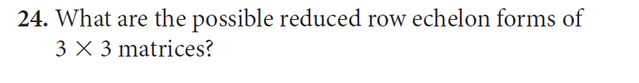
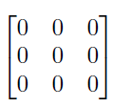
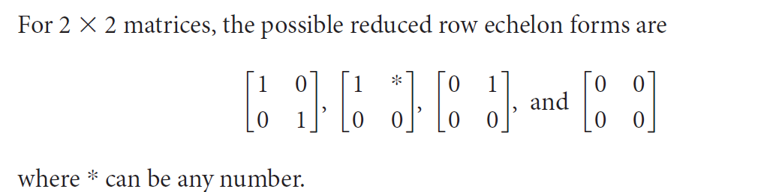
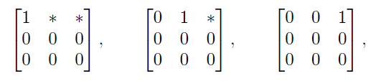
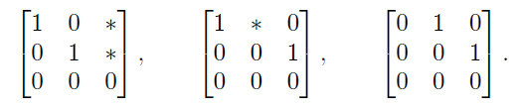
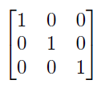

Slide 10
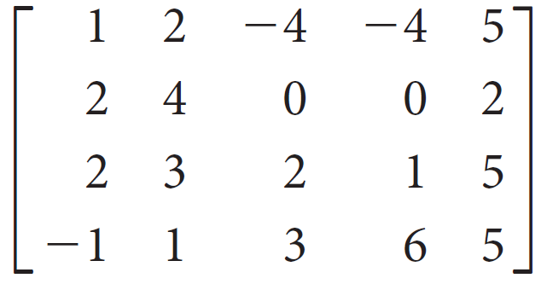
Example 2.9
Reduce the following matrix to echelon form:

Slide 11
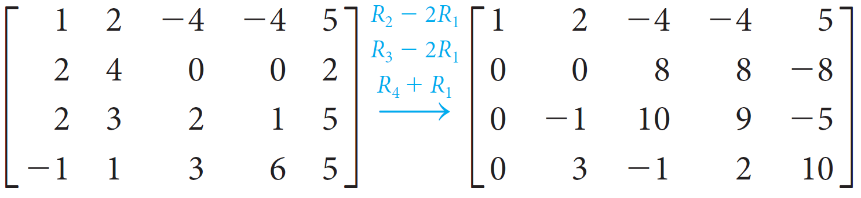
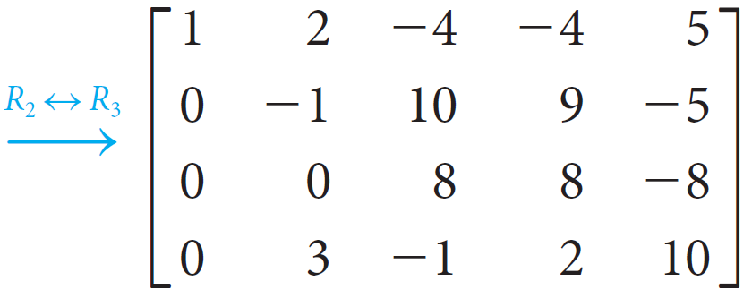
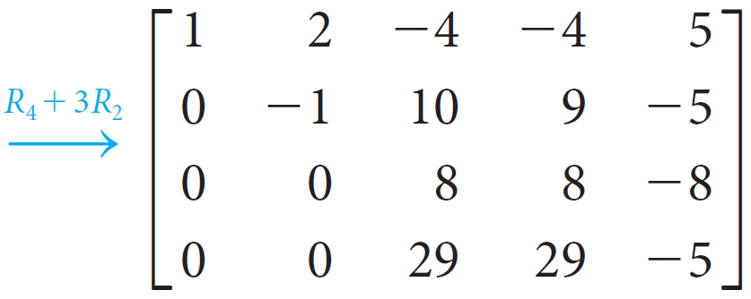
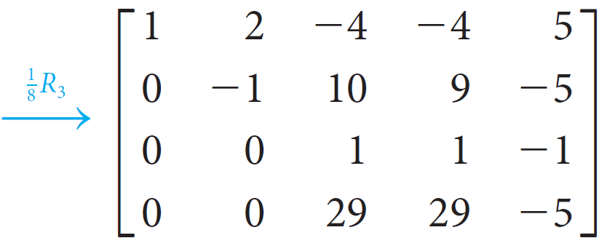
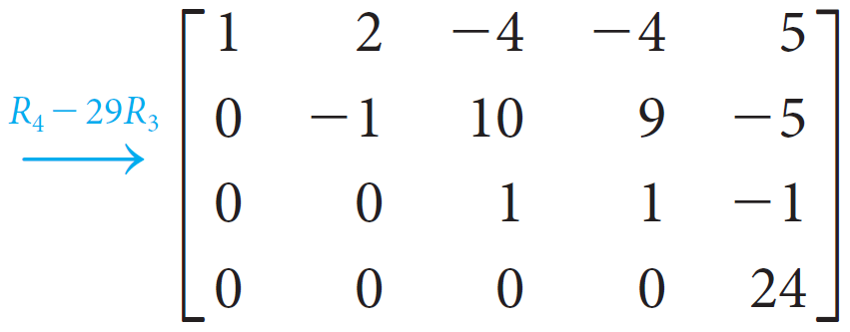

Slide 12
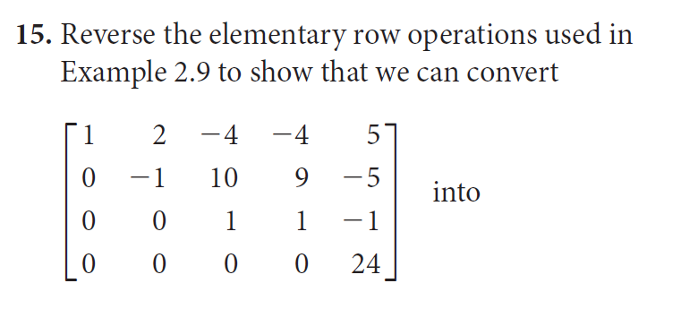
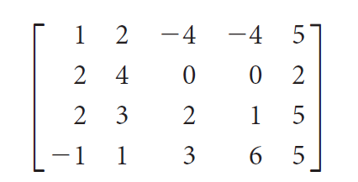

Slide 13
Row equivalent
Definition
Matrices A and B are row equivalent if there is a sequence of elementary row operations that converts A into B.
Row equivalence of matrices is an equivalent relationship
Theorem 2.1
Matrices A and B are row equivalent if and only if they can be reduced to the same row echelon form.
Theorem
Augmented matrices row equivalent, then the corresponding linear systems equivalent

Slide 14
Gaussian Elimination (1 of 2)
Gaussian Elimination
Write the augmented matrix of the system of linear equations.
2. Use elementary row operations to reduce the augmented matrix to row echelon form.
3. Using back substitution, solve the equivalent system that corresponds to the row-reduced matrix.
How to judge and solve?

Slide 15
Gaussian Elimination (2 of 2)
Definition
The rank of a matrix is the number of nonzero rows in its row echelon form.
Judge the solution set
by using rank
Theorem 2.2
The Rank Theorem
Let A be the coefficient matrix of a system of linear equations with n variables. If the system is consistent, then
number of free variables = n − rank(A)
a unique solution
infinitely many solutions
no solutions

Slide 16
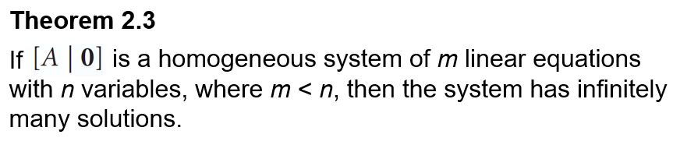
Homogeneous Systems
Definition
A system of linear equations is called homogeneous if the constant term in each equation is zero.
homogeneous system is always consistent

Slide 17
More conclusions
Indefinite system
Inconsistent
homogeneous
infinite many
homogeneous v.s. inhomogeneous

Slide 18
Gauss-Jordan Elimination (2 of 2)
Gauss-Jordan Elimination
Write the augmented matrix of the system of linear equations.
2. Use elementary row operations to reduce the augmented matrix to reduced row echelon form.
3. If the resulting system is consistent, solve for the leading variables in terms of any remaining free variables.

Slide 19
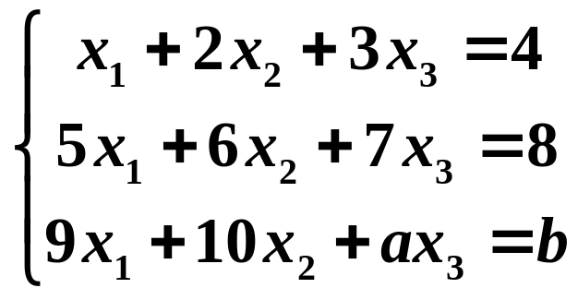
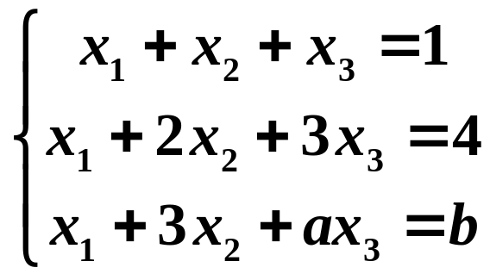
How to judge and solve?
Example
exercise

Slide 20
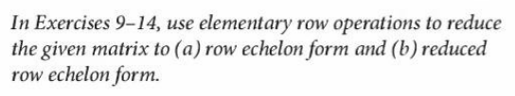
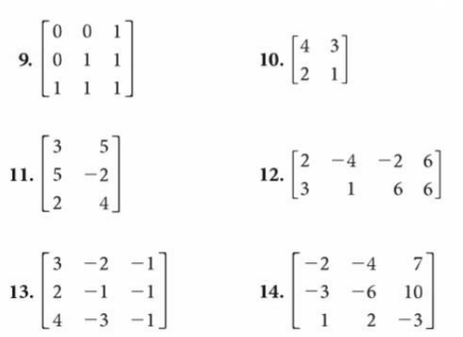
Homework 2：part 1

Slide 21
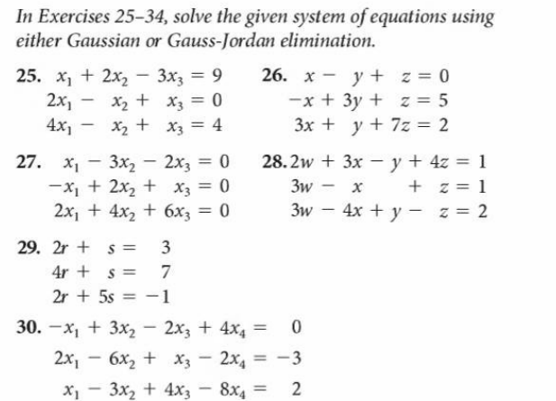
Homework 2：part 2

